Slide 1
How to generate new ideas for start up success?
Harshit Godha
Founder – Indo Israel Avocado
Partner – Vardhman Constructions

Slide 2
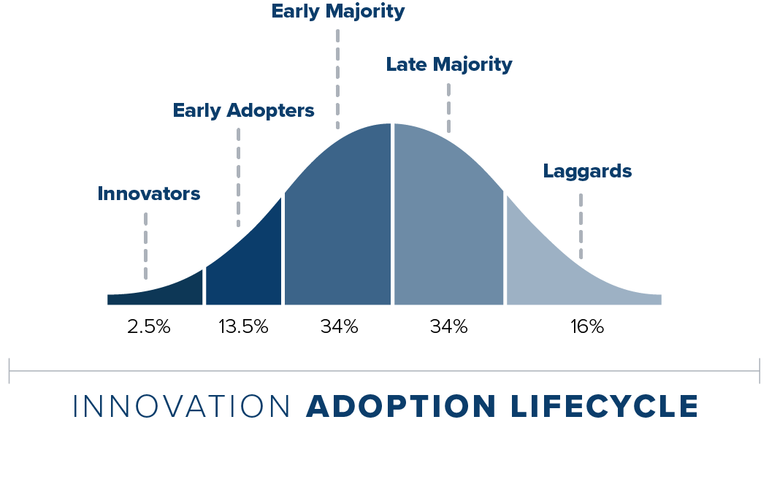
Law of diffusion of innovation
If you want mass market acceptance for your idea/product, you cannon achieve it until you cross the tipping point.

Slide 3
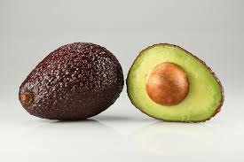
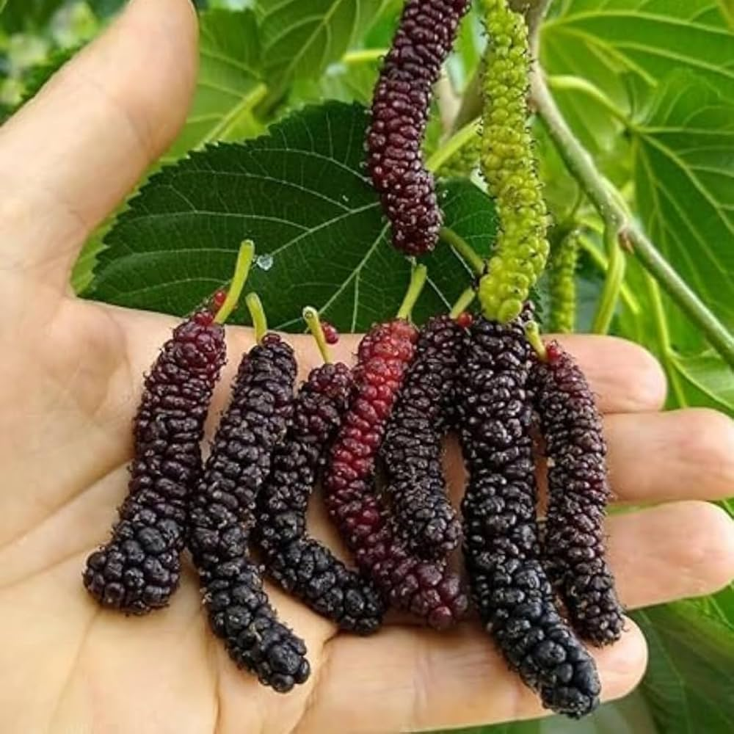
Avocado
Apple
Mulberry (shehtoot)

Slide 4
Cricket
Pickle ball

Slide 5
What happens when you choose something at the center of the curve?
Competition and high barriers to entry
Consolidation of the industry in the hands of a few
You as a small business owner will be competing in a “perfect market”
Perfect market is where all players are selling the same product, making them compete on price and not on branding
Need venture capital
Cultural innovation might work, but requires a well executed strategy

Slide 6
How to choose the right product or service?
Incremental Innovation
Disruptive Innovation
Cultural Innovation

Slide 7
Incremental Innovation

Slide 8
Disruptive Innovation (business model innovation)

Slide 9
Cultural Innovation

Slide 10
Cultural Innovation Tips – building monopolies
Don’t highlight the obvious, Liquid Death doesn’t highlight its sustainable, all other mineral water companies are doing that
Liquid death Ideology – “death to plastic”
Evoking emotions – tapping into the Limbic system
In our brains rational purchases are made through Neo Cortex and emotional purchases are made through the Limbic system
What emotion does Liquid death appeal to? (Anger, humor?)
Marketing, communications and new product development are all revolving around evoking anger but in a humorous way

Slide 12
How to get new Ideas?
Travel solo
Talk to people
Copy & Paste
Personal Branding
Read Books

Slide 13
Travel solo
How do people live in other places?
What purchases do they make?
What do they believe in?
What food do they eat?
What do they wear?

Slide 14
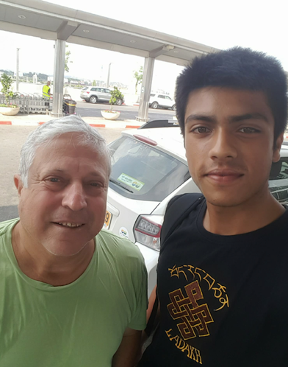
Talk to people
Older people are always willing to help
They are also lonely
Ask for guidance and learn the art of selling yourself

Slide 15
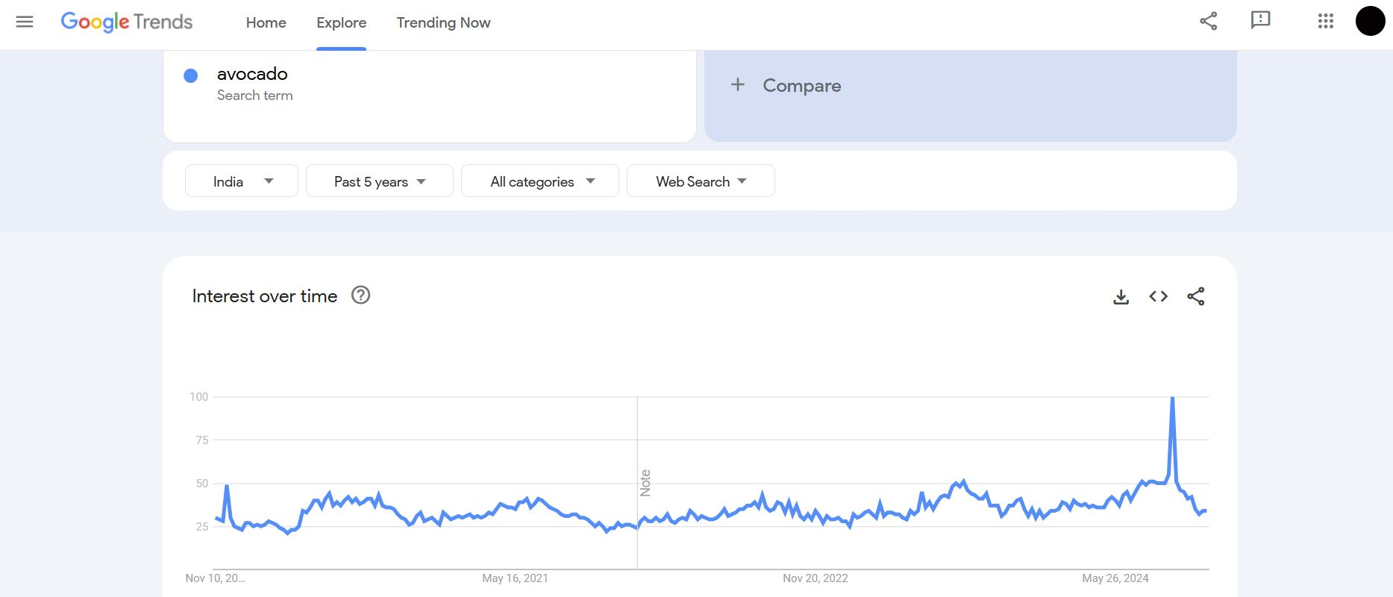
Copy & Paste
Take something from one geography and paste it in another
However, do your research first
Early adopters

Slide 16
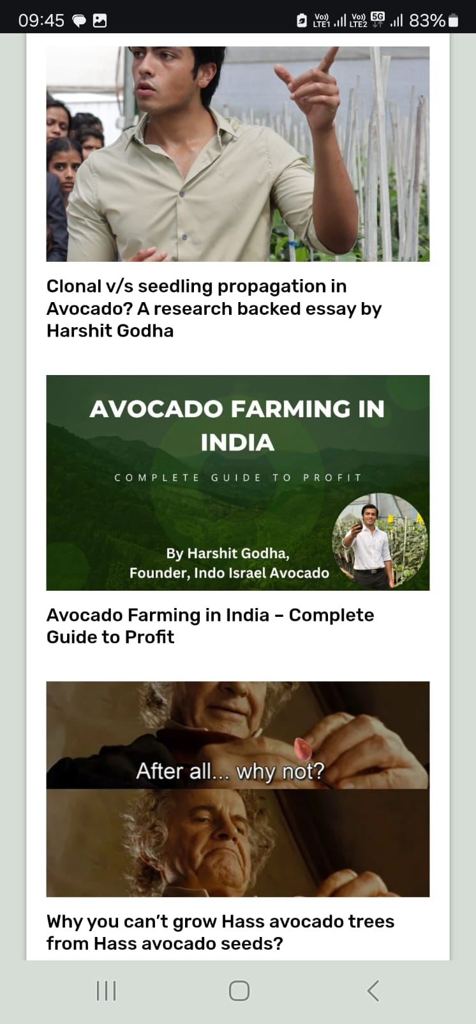
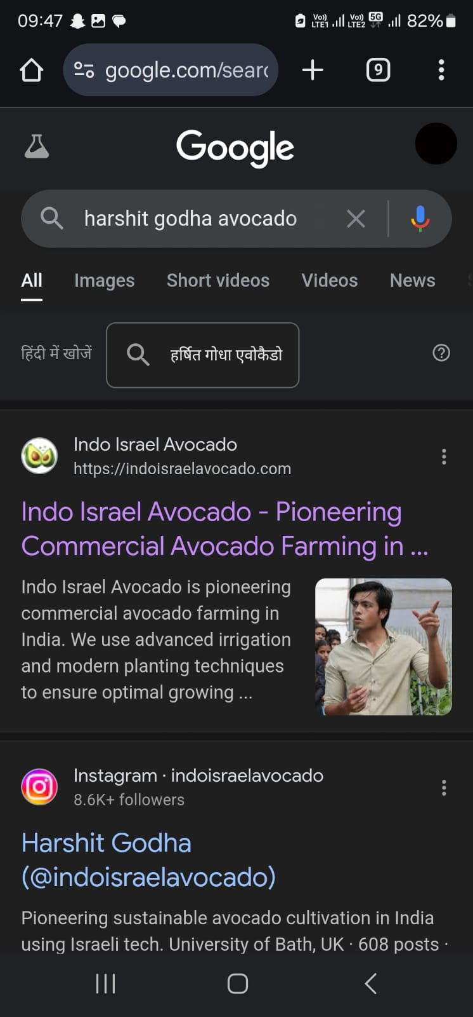
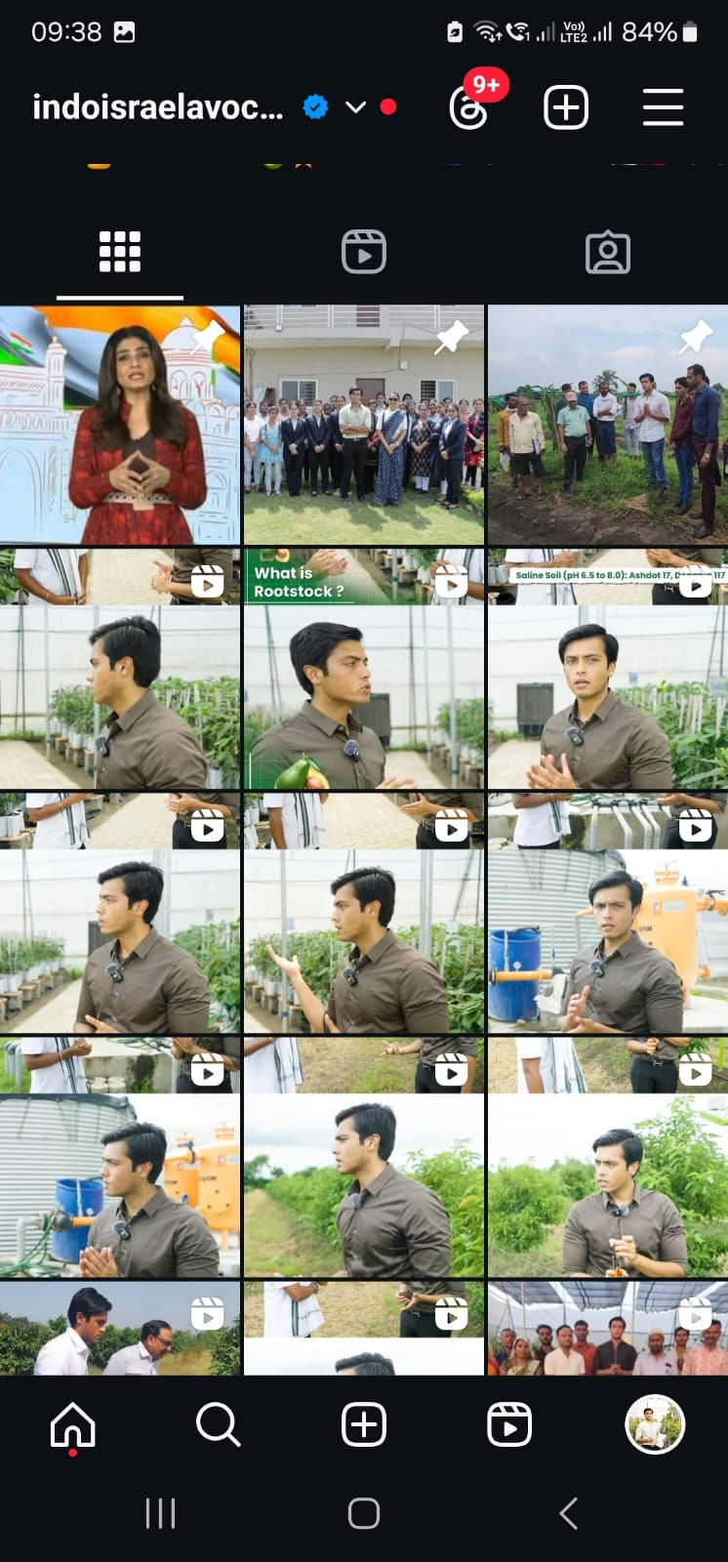
Personal Branding

Slide 17
Read Books

Slide 18
Branding strategy
Positioning
Differentiation
Re-positioning

Slide 19
Positioning
New
Blueberry
Kiwi
Dragon fruit
Avocado
Sugary
Healthy
Banana
Olives
Apple
Oranges
Old

Slide 20
Differentiation (Branding)
Local
Indian Avocado Nursery
Kerehaklu
(Kodaikanal) Avocado
History
Story
Kodaikanal Avocado
IG Deccan
Nutreefarm
Indo Israel Avocado
Imported

Slide 21
Repositioning
Sustainable
Indo Israel Avocado
Local
Imported
Indo Israel Avocado
IG Deccan
Nutreefarm
Unsustainable

Slide 22
Go-to Market strategy
1000
True fans
If you want mass market acceptance for your idea/product, you cannon achieve it until you cross the tipping point.

Slide 23
Target Market – example for Indo Israel Avocado
Who they are?
What they do?
Business men, Land lords, Well off farmers
They already have comfortable sources of income from a job or business and might want to retire and do something meaningful
What they think?
How they operate?
To diversify into high end crops, move away from traditional seasonal crops, Don’t want to give land on rent anymore because existing crops give low returns
Anil, 35 Works in tech, Based in Bangalore,
Looking to find meaning and purpose in life
They find meaning and purpose through farming, can afford a luxury lifestyle, their farms and farmhouses are often their second home with first one being in a bigger city. Use social media and often have good smart phones.

Slide 24
Creating barriers
Search Engine Optimization
Branding
Email Marketing
Social Media Marketing
Institutional Partnerships

Slide 25
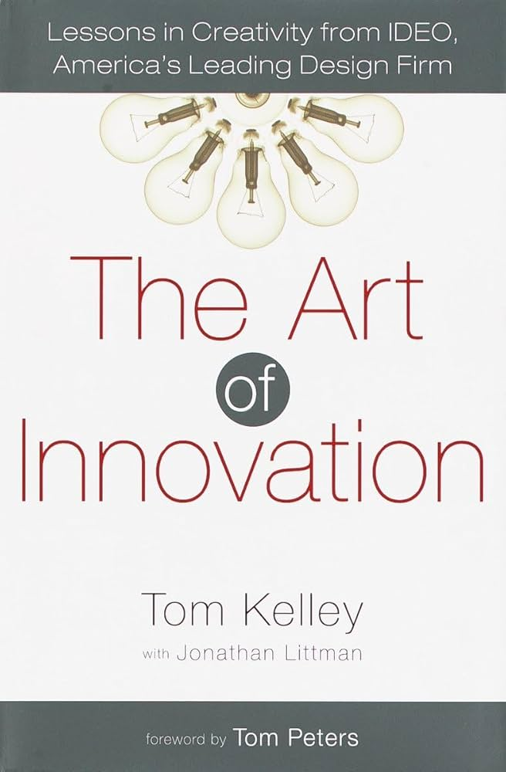
Recommended Readings

